Slide 1
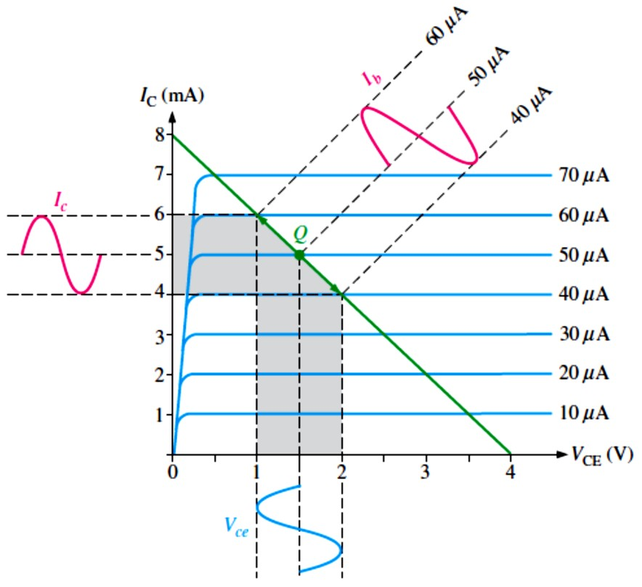
Lecture 6: BJT Amplifiers
The things we learned about biasing a transistor in Lecture 5 are now applied in this Lecture where BJT circuits are used as small-signal amplifiers.
The term small-signal refers to the use of signals that take up a relatively small percentage of an amplifier’s operational range.
We will learn how to reduce an amplifier to an equivalent dc and ac circuit for easier analysis.
6.1 Amplifier Operation
The biasing of a transistor is purely a dc operation.
The purpose of biasing is to establish a Q-point about which variations in current and voltage can occur in response to an ac input signal.
In applications where small signal voltages must be amplified, such as from an antenna or a
microphone, variations about the Q-point are relatively small.
  Amplifiers designed to handle these small ac signals are often referred to as small-signal amplifiers.
  A small-signal amplifier uses only a small portion of its load line under signal conditions.
The ac load line differs from the dc load line because the effective ac collector resistance is
�_{𝐿}in parallel with �_{C} and is less than the dc collector resistance �_{C} alone.
EXAMPLE 6-1: The ac load line operation of a certain amplifier extends 10 𝜇A above and below the Q-point base current value of 50 𝜇A, as shown in Figure 6-1. Determine the resulting peak- to-peak values of collector current and collector-to-emitter voltage from the graph.
Solution Projections on the graph of Figure 6-1 show the collector current varying from 6 mA to 4 mA for a peak-to-peak value of 2 mA and the collector-to-emitter voltage varying from 1 V to 2 V for a peak-to-peak value of 1 V.
FIGURE 6-1

Slide 2
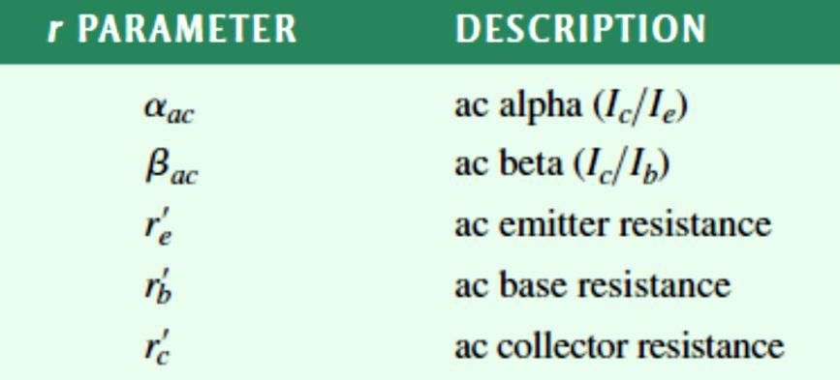
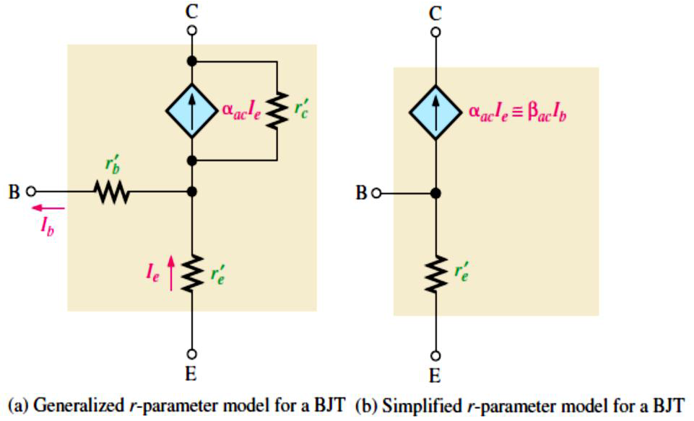
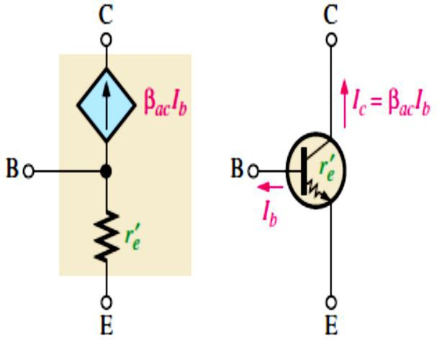
6.2 Transistor AC Models
To visualize the operation of a transistor in an amplifier circuit, it is often useful to represent it by a model circuit.
A transistor model circuit uses various internal transistor parameters to represent its operation.
Transistor models are described in this section based on resistance or r parameters. Another system of parameters, called h parameters, is briefly described.
r Parameters: The five r parameters commonly used for BJTs are given in Table 6-1. The italic lowercase letter r with a prime denotes resistances internal to the transistor.
r parameters are easily identifiable and applicable with a transistor’s circuit operation.
TABLE 6-1: r parameters.
r-Parameters for a BJT, as shown in Figure 6-2, are easily identifiable and applicable with a transistor’s circuit operation.
These Relation of transistor symbol to r-parameter model is shown in Figure 6-3.
FIGURE 6-2: r-parameter transistor model.
FIGURE 6-3: Relation of transistor symbol to r-parameter model.
Determining �’� by a Formula: For amplifier analysis, the ac emitter resistance, 𝑟’�, is the most important of the r parameters.
�’� ≅ ����⁄𝑰�
Equation 6– 1

Slide 3
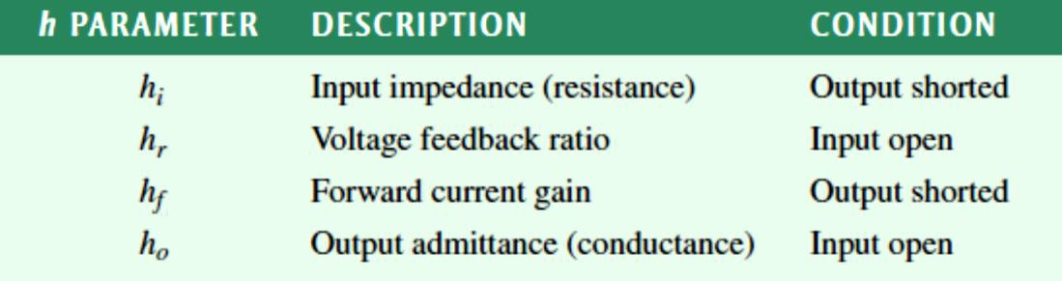
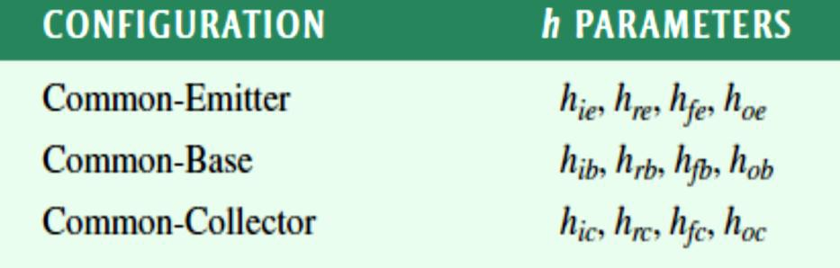
EXAMPLE 6-2: Determine the 𝑟’� of a transistor that is operating with a dc emitter current of 2 mA.
Solution 𝑟’� ≅ 25 mV⁄𝐼_{E} = 25 mV⁄2 mA = 12.5 Ω
h Parameters: The ac h parameters (hybrid) (ℎ_{𝑖}, ℎ�, ℎ�, and ℎ�), given in Table 6-2, are
important because manufacturers’ datasheets specify transistors using h parameters.
Each of the four h parameters carries a second subscript letter, as listed in Table 6-3.
The term common refers to one of the E, B, or C that is referenced to ac ground for both input and output signals.
TABLE 6–2: Basic ac h parameters.
TABLE 6–3: Subscripts of h parameters for each of the three amplifier configurations.
Relationships of h Parameters and r Parameters: The ac current ratios, ���
convert directly from h parameters as follows:
��� = ℎ��; ��� = ℎ��.
and ���,
^{ℎ}𝑟�
ℎ_{𝑟�}+1
Datasheets often provide only common-emitter h parameters. 𝑟’� = _{ℎ} ; 𝑟’� =
ℎ
;
𝑟’� = ℎ_{𝑖�} − _{ℎ}
^{ℎ}𝑟�
(1 + ℎ�� )
𝑜�
𝑜�
𝑜�
6.3 The Common-Emitter Amplifier
A common-emitter amplifier has high voltage, current, and power gains, but a relatively low input resistance.
Swamping is a method of stabilizing the voltage gain.
Circuit with Voltage-Divider Bias: Figure 6-4 shows a common-emitter amplifier with voltage-divider bias.
Input is at the base. Output is at the collector.
There is a phase inversion from input �_{𝑖�} to output ���� (���� is 180° out of phase with �_{𝑖�}).

Slide 4
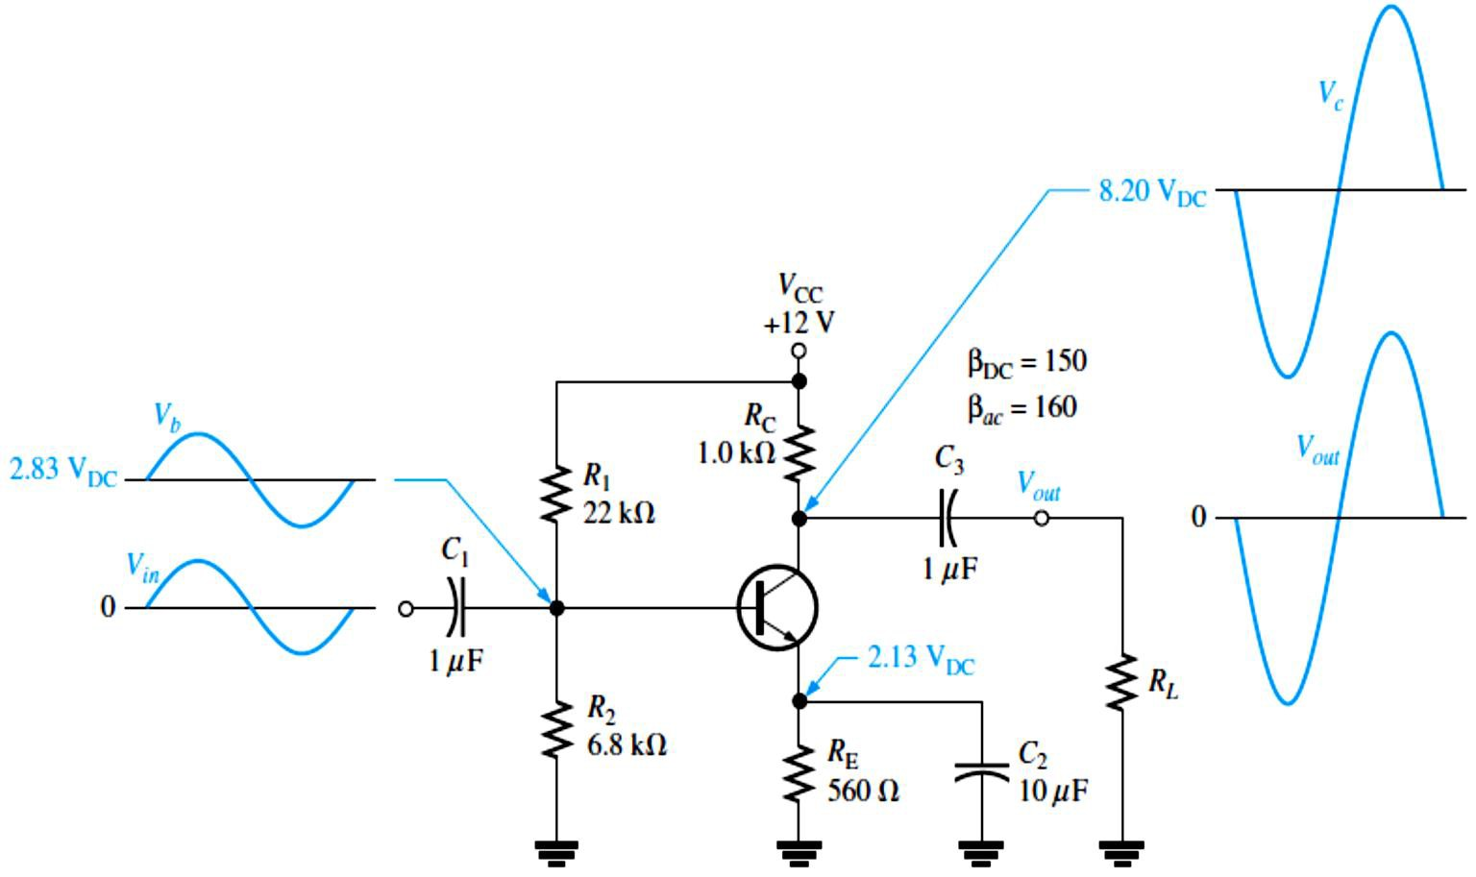
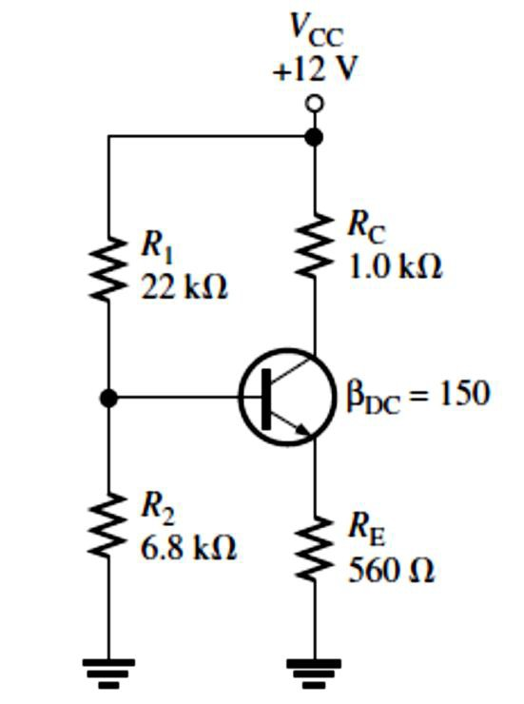
�₁ and 𝐶₃ are coupling capacitors for the input and output signals.
𝐶₂ is the emitter-bypass capacitor from emitter to ground, so emitter is at ac ground.
All capacitors must have a negligible reactance at the frequency of operation, so they appear as shorts.
FIGURE 6-4: A common-emitter amplifier.
Equivalent Circuits and Formulas: DC Analysis:
To analyze the amplifier in Figure 6-4, the dc bias values must first be determined.
  A dc equivalent circuit shown in Figure 6-5 is developed by removing the coupling and bypass capacitors because they appear open as far as the dc bias is concerned. This also removes the load resistor and signal source.
DC formulas:
𝑹_{𝐓�}= (𝑹�𝑹�)⁄(𝑹� + 𝑹�)
𝑽_{𝐓�}= (_{𝑹}
𝑹�
_{+ 𝑹}^{) 𝑽}��
� �
𝑰� = _{𝑹}
^{𝑽}𝐓�^{− 𝑽}��
�
+ 𝑹⁄𝜷
𝐓���
𝑽� = 𝑰�𝑹�
𝑽�� = 𝑽� − 𝑽�
𝑽� = 𝑽�� + 𝑽�
𝑽� = 𝑽�� − 𝑰�𝑹�
FIGURE 6-5: DC equivalent circuit for the amplifier in Figure 6-4.

Slide 5
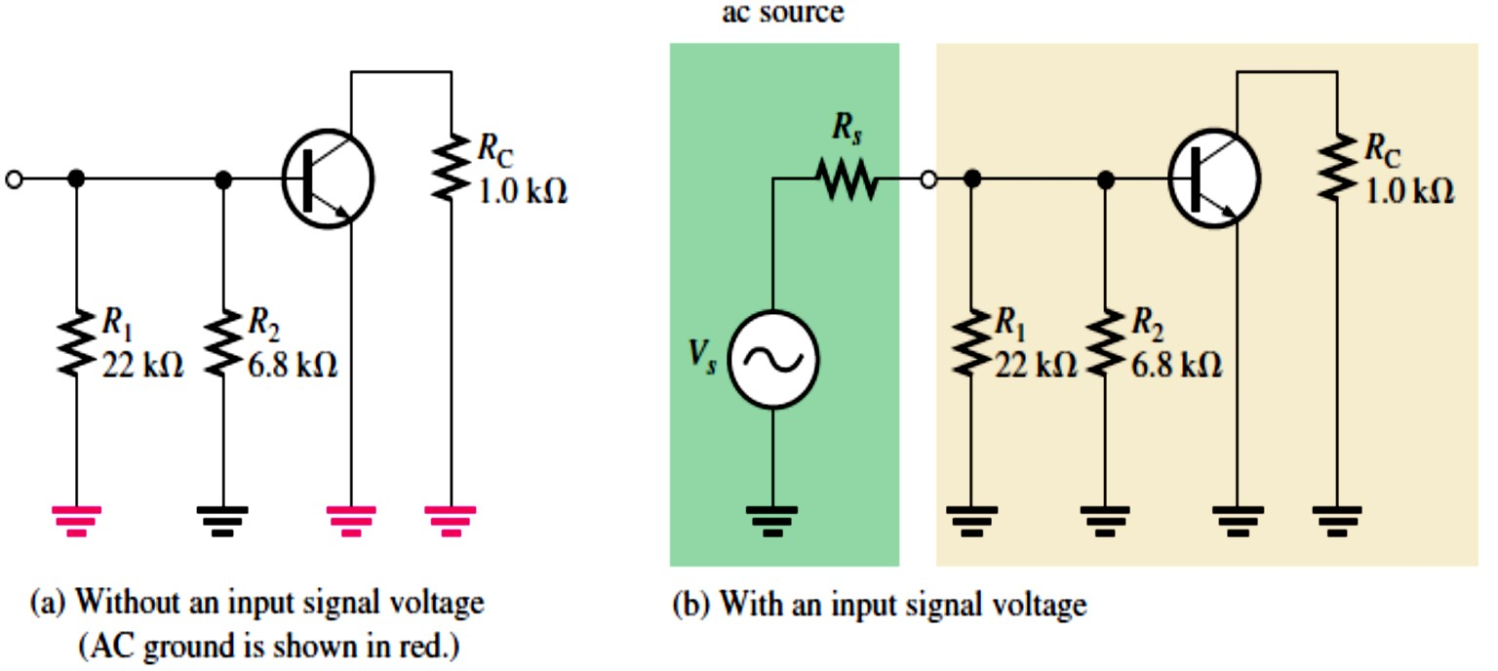
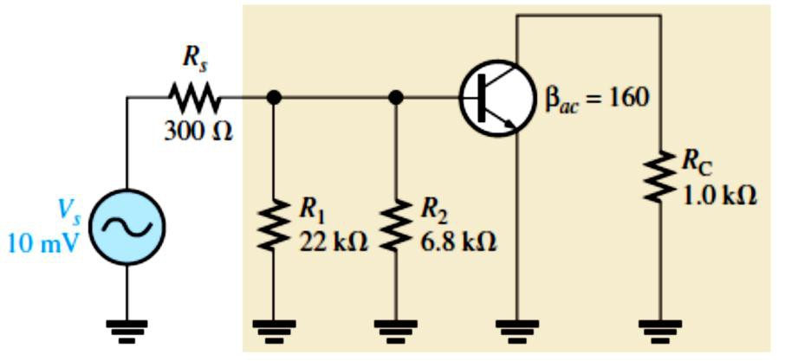
AC Analysis: To analyze the ac signal operation of an amplifier, an ac equivalent circuit, shown in Figure 6-6, is developed as follows: The capacitors �₁, 𝐶₂, and 𝐶₃ are replaced by effective shorts because their values are selected so that 𝑋_{𝐶}is negligible at the signal frequency and can be considered to be 0 𝛀. The dc source is replaced by ground (ac ground).
AC formulas:
����
�’� ≅ _{𝑰}
�
^{𝑹}𝒊�(����) ^{= 𝜷}���’�
^{𝑹}��� ^{≅ 𝑹}�
𝑰� 𝑰� 𝑨= =
^{𝒊𝑰}� ^{𝑰}𝒊�
𝑨� = 𝑨’�𝑨_{𝒊}
FIGURE 6-6: AC equivalent circuit for the amplifier in Figure 6–8. Voltage Gain With the Emitter Bypass Capacitor 𝑨� = 𝑹�⁄�’� Voltage Gain Without the Emitter Bypass Capacitor (𝑹� decreases the ac voltage gain) 𝑨� = 𝑹�⁄(�’� + 𝑹�) EXAMPLE 6-3: Determine the signal voltage at the base of the transistor in Figure 6-7. This circuit is the ac equivalent of the amplifier in Figure 6-4 with a 10 mV rms, 300 Ω signal source. 𝐼_{E} was previously found to be 3.80 mA. FIGURE 6-7 Solution First, we determine the ac emitter resistance. 25 mV 25 mV E Then, �_{𝑖�(����)} = ��� 𝑟’� = 160 (6.58 Ω) = 1.05 kΩ Next, we determine the total input resistance viewed from the source. 1 1 �₁ ⁺ �₂ ⁺ �_{𝑖�(����)} 22 kΩ ⁺ 6.8 kΩ ⁺ 1.05 kΩ 5

Slide 6
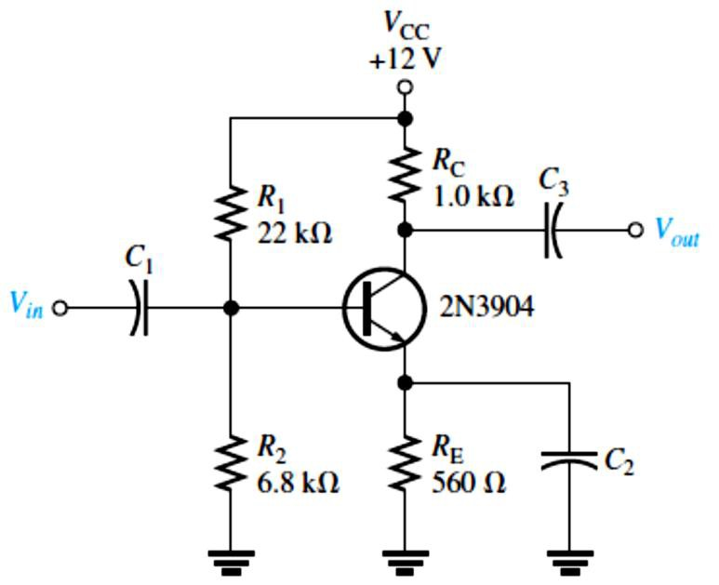
The source voltage is divided down by �� and �_{𝑖�(���)}, so the signal voltage at the base is the voltage across �_{𝑖�(���)}.
�� = (�_{𝑖�(���)}⁄(�� + �_{𝑖�(���)}))�� = (873 Ω⁄(300 Ω + 873 Ω))10 mV = 7.44 mV
As we can see, there is significant attenuation (reduction) of the source voltage due to the source resistance and amplifier’s input resistance combining to act as a voltage divider.
EXAMPLE 6-4: Select a minimum value for the emitter bypass capacitor, 𝐶₂, in Figure 6-8 if the amplifier must operate over a frequency range from 200 Hz to 10 kHz.
FIGURE 6-8
Solution The 𝑋_{𝐶}of the bypass capacitor, 𝐶₂, should be at least ten times less than �_{E}.
��𝑿_{𝑪�} ≤ 𝑹�
𝑋_{𝐶2} = �_{E}⁄10 = 560 Ω⁄10 = 56 Ω
We can determine the capacitance value at
the minimum frequency of 200 Hz as follows:
𝑋_{𝐶2} = 1⁄(2𝜋�𝐶₂)
1
𝐶₂ = 1⁄(2𝜋�𝑋_{𝐶2} ) = _{2𝜋(200 Hz)(56 Ω)} = 14.2 𝜇F
This is the minimum value for the bypass capacitor for this circuit. We can always use a larger value, although cost and physical size may impose limitations.
EXAMPLE 6-5: Calculate the base-to-collector voltage gain of the amplifier in Figure 6-8 both without and with an emitter bypass capacitor if there is no load resistor.
Solution From Example 6-3, 𝑟’� = 6.58 Ω for this same amplifier. Without 𝐶₂, the gain is
𝐴� = �_{C}⁄(𝑟’� + �_{E}) = 1.0 kΩ⁄(6.58 Ω + 560 Ω) = 1.76
With 𝐶₂, the gain is 𝐴� = �_{C}⁄𝑟’� = 1.0 kΩ⁄6.58 Ω = 152
As we can see, the bypass capacitor makes quite a difference.
Effect of a Load on the Voltage Gain: A load is the amount of current drawn from the output of an amplifier or other circuit through a load resistance.
The total ac collector resistance �� at the signal frequency is
�� = (�_{C}�_{𝐿})⁄(�_{C} + �_{𝐿})
Replacing �_{C} with �� in the voltage gain expression gives
𝑨� = 𝑹�⁄�’�
When �� < �_{C} because of �_{𝐿}, the voltage gain is reduced. However, if �_{𝐿}≫ �_{C}, then �� ≅
�_{C}, and the load has very little effect on the gain.

Slide 7
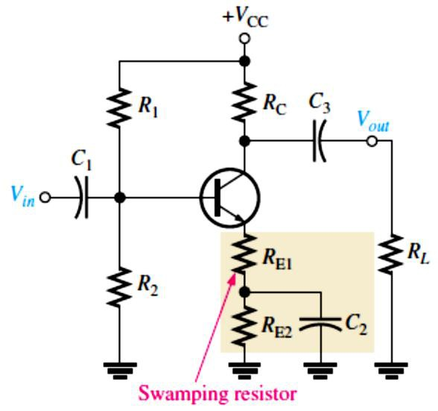
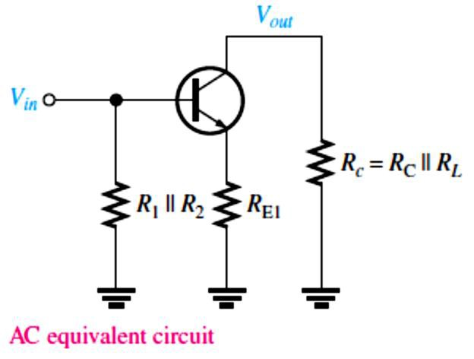
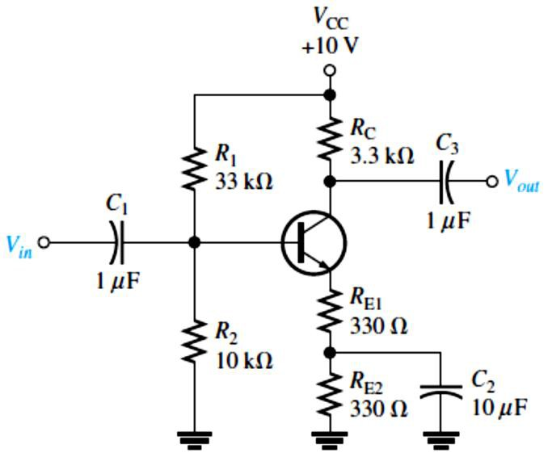
EXAMPLE 6-6: Calculate the base-to-collector voltage gain of the amplifier in Figure 6-8 when a load resistance of 5 kΩ is connected to the output. The emitter is effectively bypassed and 𝑟’� =
6.58 Ω.
Solution The ac collector resistance is
�� = (�_{C}�_{𝐿})⁄(�_{C} + �_{𝐿}) = (1.0 kΩ)(5 kΩ)⁄(1.0 kΩ + 5 kΩ) = 833 Ω
Therefore, 𝐴� = ��⁄𝑟’� = 833 Ω⁄6.58 Ω = 127
The unloaded gain was found to be 152 in Example 6-5.
Swamping �’� to Stabilize the Voltage Gain: Swamping, as indicated in Figure 6-9, is a method used to stabilizes voltage gain by minimizing the effect of 𝑟’�.
Swamping reduces the voltage gain from its unswamped value.
Swamping increases input resistance.
The load resistance reduces the voltage gain. The smaller the load resistance, the less the gain.
FIGURE 6-9: A swamped amplifier.
AC formulas: 𝐴� ≅ �_{C}⁄�_{E1}
where �� = �_{C} ∥ �_{𝐿}= (�_{C}�_{𝐿})⁄(�_{C} + �_{𝐿});
�𝑖�(����) ^{= �}�� ^{(𝑟’}� ^{+ �}E1⁾
EXAMPLE 6-7: Determine the voltage gain of the swamped amplifier in Figure 6-10. Assume that the bypass capacitor has a negligible reactance for the frequency at which the amplifier is operated. Assume 𝑟’� = 20 Ω.
FIGURE 6-10
Solution �_{E2} is bypassed by 𝐶₂.
�_{E1} is more than ten times 𝑟’� so the approximate voltage gain is
𝐴� ≅ �_{C}⁄�_{E1} = 3.3 kΩ⁄330 Ω = 10

Slide 8
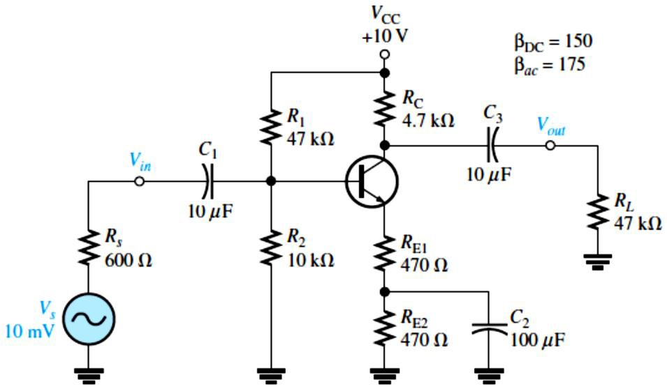
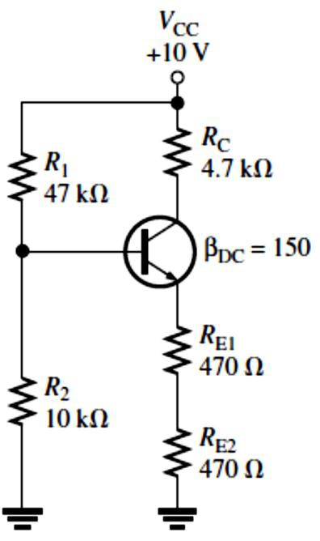
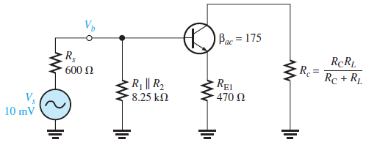
EXAMPLE 6-8: For the amplifier in Figure 6-11,
Determine the dc collector voltage.
Determine the ac collector voltage.
Draw the total collector voltage waveform and the total output voltage waveform.
FIGURE 6-11
Solution (a) We can determine the dc bias values using the dc
equivalent circuit in Figure 6-12.
Applying Thevenin’s theorem and Kirchhoff’s voltage law to the base-emitter circuit in Figure 6-12.
FIGURE 6-12: DC equivalent for the circuit in Figure 6-11.
�_{TH} = �
�₁�₂
=
(47 kΩ)(10 kΩ )
= 8.25 kΩ
1
+ �
2
47 kΩ + 10 kΩ
�_{TH} = (�
�₂
10 kΩ
) 10 V = 1.75 V
+ � ^{) �CC = (}47 kΩ + 10 kΩ
1 2
1.75 V − 0.7 V
⁼ (470 Ω + 470 Ω) + 8.25 kΩ⁄150 ^{= 1.06 mA}
𝐼_{E} = �
�TH ^{− �}BE
+ � ⁄�
E TH DC
𝐼_{C} ≅ 𝐼_{E} = 1.06 mA
�_{E} = 𝐼_{E}(�_{E1} + �_{E2}) = (1.06 mA)(470 Ω + 470 Ω) = 1 V
�_{BE} = �_{B} − �_{E}
�_{B} = �_{BE} + �_{E} = 0.7 V + 1 V = 1.7 V
�_{C} = �_{CC} − 𝐼_{C}�_{C} = 10 V − (1.06 mA)(4.7 kΩ) = 5.02 V
(b) The ac analysis is based on the ac equivalent circuit in Figure 6-13.
FIGURE 6-13: AC equivalent for the circuit in Figure 6-11.

Slide 9
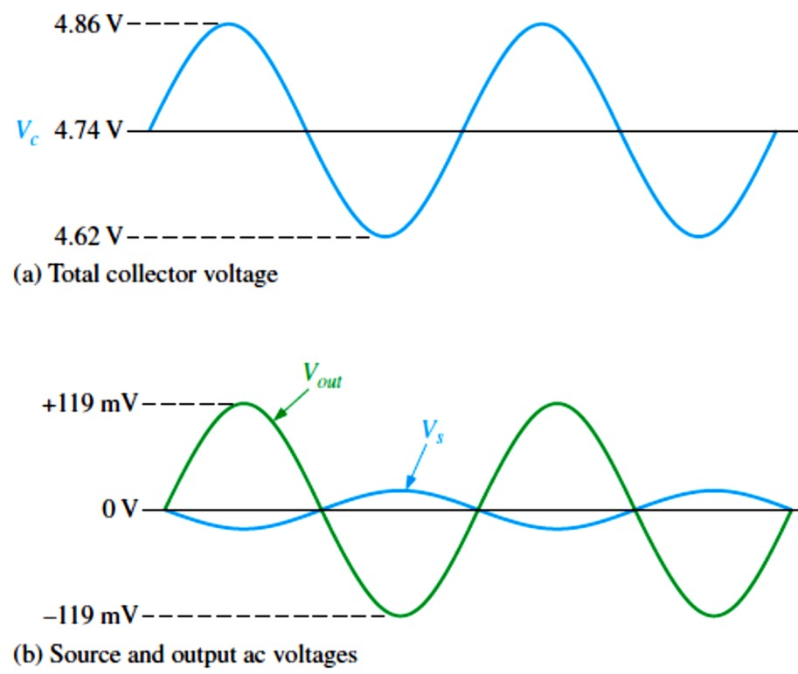
The first thing to do in the ac analysis is calculate 𝑟’�.
𝑟’� ≅ 25 mV⁄𝐼_{E} = 25 mV⁄1.06 mA = 23.6 Ω
Next, we determine the attenuation in the base circuit. Looking from the 600 Ω source, the total
�𝑖� ^{is �}𝑖�(���) ^{= �}1 ∥ �2 ∥ �𝑖�(����)
�_{𝑖�(����)} = ��� (𝑟’� + �_{E1}) = 175(23.6 Ω + 470 Ω) = 86.5 kΩ
Therefore, �_{𝑖�(���)} = 47 kΩ ∥ 10 kΩ ∥ 86.5 kΩ = 7.53 kΩ
The attenuation from source to base is
attenuation = ��⁄�� = (�� + �_{𝑖�(���)})⁄�_{𝑖�(���)} = (600 Ω + 7.53 kΩ)⁄7.53 kΩ = 1.08
Before 𝐴� can be determined, we must know the ac collector resistance �� .
�� = (�_{C}�_{𝐿})⁄(�_{C} + �_{𝐿}) = (4.7 kΩ)(47 kΩ)⁄(4.7 kΩ + 47 kΩ) = 4.27 kΩ
The voltage gain from base to collector is
𝐴� ≅ ��⁄�_{E1} = 4.27 kΩ⁄470 Ω = 9.09
The overall voltage gain is the reciprocal of the attenuation times the amplifier voltage gain.
𝐴’� = (�� ⁄��)𝐴� = (1⁄attenuation)𝐴� = (1⁄1.08)(9.09) = 8.45
The source produces 10 mV rms, so the rms voltage at the collector is
𝐴’� = ��⁄��
�� = 𝐴’��� = (8.45)(10 mV) = 84.5 mV
(c) The total collector voltage is the signal voltage of 84.5 mV rms riding on a dc level of 4.74 V, as shown in Figure 6-14(a), where approximate peak values are determined as follows:
FIGURE 6-14: Voltages for Figure 6-11.
Since
��(�) ��(�)
��(rms) ⁼
Then
=
1.414
√2
��(�) ^{= 1.414 �}�(rms)
So
Max �_{�(�)} = �_{C} + 1.414 ��
Max �_{�(�)} = 4.74 V + 1.414 (84.5 mV)
Max �_{�(�)} = 4.86 V
Min �_{�(�)} = �_{C} − 1.414 ��
Min �_{�(�)} = 4.74 V − 1.414 (84.5 mV)
Min �_{�(�)} = 4.62 V
The coupling capacitor, 𝐶₃, keeps the dc level from getting to the output. So, ���� is equal to the ac component of the collector voltage �_{���(�)} = 1.414(84.5 mV) = 119 mV, as indicated in Figure 6-14(b). The source voltage, ��, is shown to emphasize the phase inversion.

Slide 10
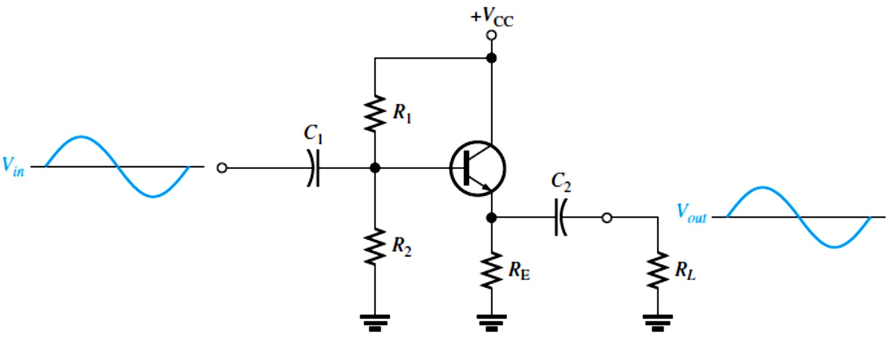
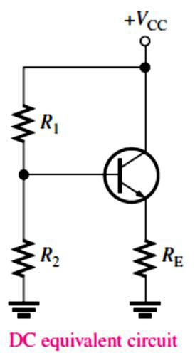
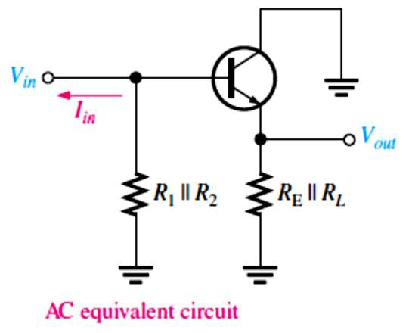
6.4 The Common-Collector Amplifier
A common-collector amplifier has high input resistance and high current gain, but its voltage gain is approximately 1.
A Darlington pair provides beta multiplication for increased input resistance.
A common-collector amplifier is known as an emitter-follower.
Circuit with Voltage-Divider Bias is shown in Figure 6-15.
Input is at the base. Output is at the emitter.
There is no phase inversion from input to output.
Input resistance is high. Output resistance is low.
Maximum voltage gain is 1.
Collector is at ac ground.
Coupling capacitors must have a negligible reactance at the frequency of operation.
FIGURE 6-15: Emitter-follower with voltage-divider bias.
Equivalent Circuits and Formulas: DC formulas:
𝑹_{𝐓�}= (𝑹�𝑹�)⁄(𝑹� + 𝑹�)
𝑽_{𝐓�}= (𝑹�⁄(𝑹� + 𝑹�))𝑽��
𝑰� = (𝑽_{𝐓�}− 𝑽��)⁄(𝑹� + 𝑹_{𝐓�}⁄𝜷��)
𝑽� = 𝑰�𝑹�
𝑽�� = 𝑽� − 𝑽�
𝑽� = 𝑽�� + 𝑽�
𝑽� = 𝑽��
AC formulas:
�’� ≅ ����⁄𝑰�
^{𝑹}𝒊�(����) ^{= 𝜷}��^{(�’}� ^{+ 𝑹}�^{) ≅ 𝜷}��^{𝑹}�
𝑹��� ≅ (𝑹�⁄𝜷��) ∥ 𝑹�
𝑨� = 𝑹�⁄(�’� + 𝑹�) ≅ �
𝑨_{𝒊}= 𝑰�⁄𝑰_{𝒊�}
𝑨� ≅ 𝑨_{𝒊}

Slide 11
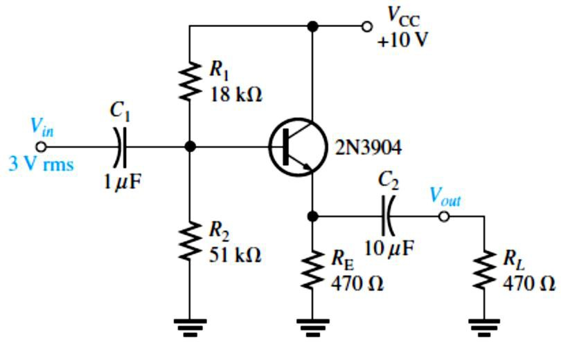
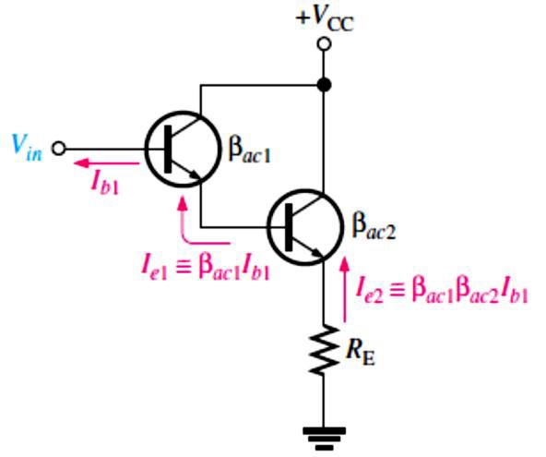
EXAMPLE 6-9: Determine the total input resistance of the emitter-follower in Figure 6-16. Also find the voltage gain, current gain, and power gain in terms of power delivered to the load, �_{𝐿}. Assume ��� = 175 and that the capacitive reactances are negligible at the frequency of operation.
FIGURE 6-16
Solution The ac emitter resistance external to the transistor is
�� = �_{E} ∥ �_{𝐿}= �_{E}�_{𝐿}⁄�_{E} + �_{𝐿} (470 Ω)(470 Ω)
^{�� =} 470 Ω + 470 Ω ^{= 235 Ω}
The approximate resistance, looking in at the base, is
�_{𝑖�(����)} ≅ ��� �� = (175)(235 Ω) = 41.1 kΩ
The total input resistance is
�_{𝑖�(���)} = �₁ ∥ �₂ ∥ �_{𝑖�(����)} = 1⁄(1⁄18 kΩ + 1⁄51 kΩ + 1⁄41.1 kΩ) = 10.1 kΩ
𝐴� ≅ 1 .By using 𝑟’�, we can determine a more precise value of 𝐴� if necessary.
�_{BE} = �_{B} − �_{E} = (�₂⁄(�₁ + �₂))�_{CC} − �_{E}
�_{E} = (�₂⁄(�₁ + �₂))�_{CC} − �_{BE} = (18 kΩ⁄(18 kΩ + 18 kΩ))10 V − 0.7 V = 6.69 V
Therefore, 𝐼_{E} = �_{E}⁄�_{E} = 6.69 V⁄470 Ω = 14.2 mA
And 𝑟’� ≅ 25 mV⁄𝐼_{E} = 25 mV⁄14.2 mA = 1.76 Ω
So, 𝐴� = ��⁄𝑟’� + �� = 235 Ω⁄1.76 Ω + 235 Ω = 235 Ω⁄237 Ω = 0.992
The small difference in 𝐴� as a result of considering 𝑟’� is insignificant in most cases. The current gain is 𝐴_{𝑖}= 𝐼� ⁄𝐼_{𝑖�}. The calculations are as follows:
𝐼� = ��⁄�� = 𝐴��� ⁄�� ≅ (0.992)(3 V)⁄235 Ω = 2.98 V⁄235 Ω = 12.7 mA
𝐼_{𝑖�} = �_{𝑖�}⁄�_{𝑖�(���)} = 3 V⁄10.1 kΩ = 297 𝜇A
𝐴_{𝑖}= 𝐼� ⁄𝐼_{𝑖�} = 12.7 mA⁄297 𝜇A = 42.8
The power gain is 𝐴� ≅ 𝐴_{𝑖}= 42.8
Since �_{𝐿}= �_{E}, one-half of the power is dissipated in �_{E} and one-half in �_{𝐿}. Therefore, in terms of power to the load, the power gain is 𝐴_{�(����)} = 𝐴�⁄2 = 42.8⁄2 = 21.4
The Darlington Pair: ��� is a major factor in determining the input resistance of an amplifier.
One way to boost input resistance is to use a Darlington pair, as shown in Figure 6-17.
^{𝑹}𝒊� ^{= 𝜷}��^{𝑹}� ^{= 𝜷}���^{𝜷}���^{𝑹}�
FIGURE 6-17: A Darlington pair multiplies ���.

Slide 12
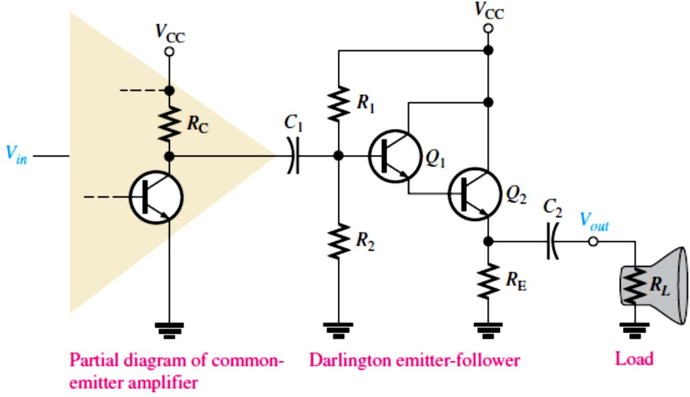
EXAMPLE 6-10: In Figure 6-18 for the common-emitter amplifier, �_{CC} = 12 V, �_{C} = 1.0 kΩ and 𝑟’� = 5 Ω. For the Darlington emitter-follower, �₁ = 10 kΩ, �₂ = 22 kΩ, �_{E} = 22 Ω, �_{𝐿}= 8 Ω, �_{CC} = 12 V, and �_{DC} = ��� = 100 for each transistor. Neglect �_{IN(BASE)} of the Darlington.
Determine the voltage gain of the common-emitter amplifier.
Determine the voltage gain of the Darlington emitter-follower.
Determine the overall voltage gain and compare to the gain of the common-emitter amplifier driving the speaker directly without the Darlington emitter-follower.
Solution (a) To determine 𝐴� for the common-emitter amplifier, first we find 𝑟’� for the
Darlington emitter-follower.
�_{B} = (�₂⁄(�₁ + �₂))�_{CC}
22 kΩ
FIGURE 6-18
^{�B = (}10 kΩ + 22 kΩ
) 12V =
�_{B} = 8.25 V
2�_{BE} = �_{B} − �_{E} ⟹ �_{E} = �_{B} − 2�_{BE}
�_{E} = 8.25 V − 2(0.7 V) = 6.85 V
𝐼_{E} = �_{E}⁄�_{E} = 6.85 V⁄22 Ω = 311 mA
𝑟’� ≅ 25 mV⁄𝐼_{E} = 25 mV⁄311 mA
𝑟’� = 80 mΩ
2
2
�_{E} must dissipate a power of �_{�E} = 𝐼_{E} �_{E} = (311 mA) (22 Ω) = 2.13 W
and transistor �₂ must dissipate �_{�2} = (�_{CC} − �_{E})𝐼_{E} = (12 V − 6.85 V)(311 mA) = 1.6 W
Next, the ac emitter resistance of the Darlington emitter-follower is
�� = �_{E} ∥ �_{𝐿}= 22 Ω ∥ 8 Ω = (22 Ω)(8 Ω)⁄(22 Ω + 8 Ω) = 5.87 Ω
The total input resistance of the Darlington emitter-follower is
�_{𝑖�(���)} = �₁ ∥ �₂ ∥ ��� ²(𝑟’� + �� ) =
1
= 6.16 kΩ
1 1 1
10 kΩ ⁺ 22 kΩ ⁺ (100)²(80 mΩ + 5.87 Ω)
The effective ac collector resistance of the common-emitter amplifier is
�� = �_{C} ∥ �_{𝑖�(���)} = (1.0 kΩ)(6.16 kΩ)⁄(1.0 kΩ + 6.16 kΩ) = 860 Ω
The voltage gain of the common-emitter amplifier is 𝐴� = ��⁄𝑟’� = 860 Ω⁄5 Ω = 172
The voltage gain for the Darlington emitter-follower is
𝐴� = ��⁄(𝑟’� + �� ) = 5.87 Ω⁄(80 mΩ + 5.87 Ω) = 0.99
The overall voltage gain is 𝐴’� = 𝐴_{�(EF)}𝐴_{�(CE)} = (0.99)(172) = 170
If the common-emitter amplifier drives the speaker directly, the gain is
�� = (�_{C}�_{𝐿})⁄(�_{C} + �_{𝐿}) = (1.0 kΩ)(8 Ω)⁄(1.0 kΩ + 8 Ω) = 7.94 Ω
𝐴� = ��⁄𝑟’� = 7.94 Ω⁄5 Ω = 1.59

Slide 13
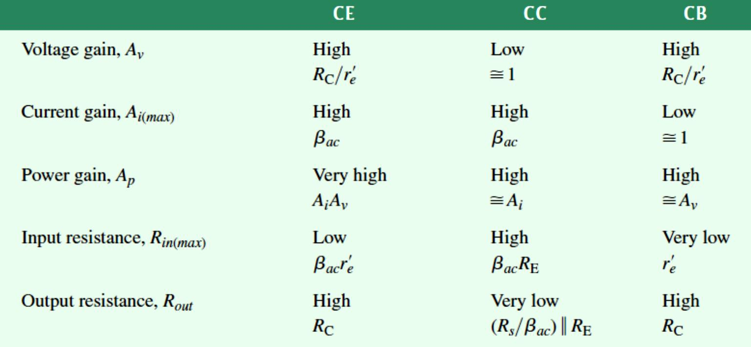
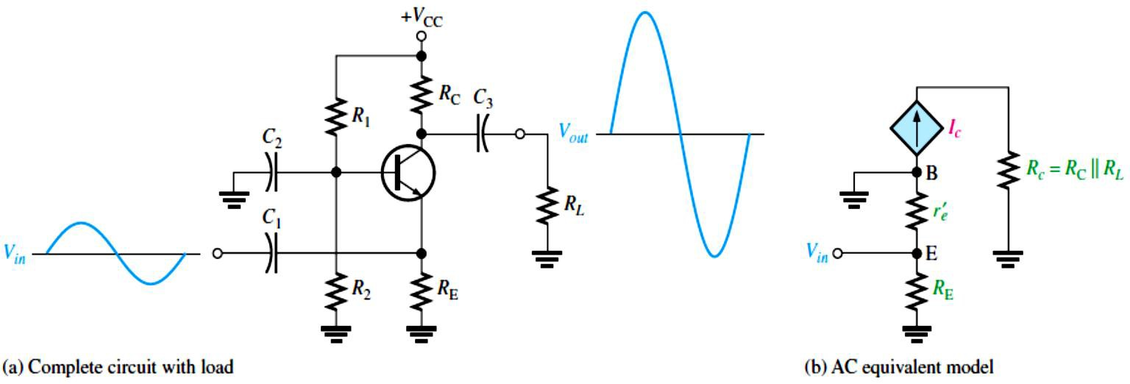
6.5 The Common-Base Amplifier
The common-base amplifier has a high voltage gain, but it has a very low input resistance and its current gain is approximately 1.
Common-emitter, common-collector, and common-base amplifier configurations are summarized in Table 6-4.
TABLE 6-4: Relative comparison of amplifier configurations. The current gains and the input and output resistances are the approximate maximum achievable values, with the bias resistors neglected.
Circuit with Voltage-Divider Bias: A common-base amplifier is shown in Figure 6-19.
Input is at the emitter. Output is at the collector.
There is no phase inversion from input to output.
Input resistance is low. Output resistance is high.
Maximum current gain is 1.
Base is at ac ground.
FIGURE 6-19: Common-base amplifier with voltage-divider bias.

Slide 14
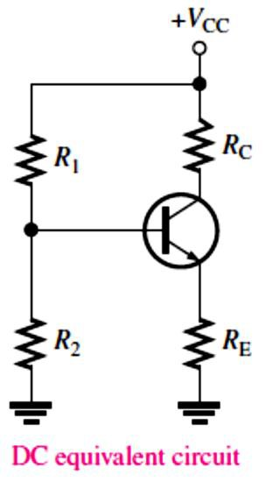
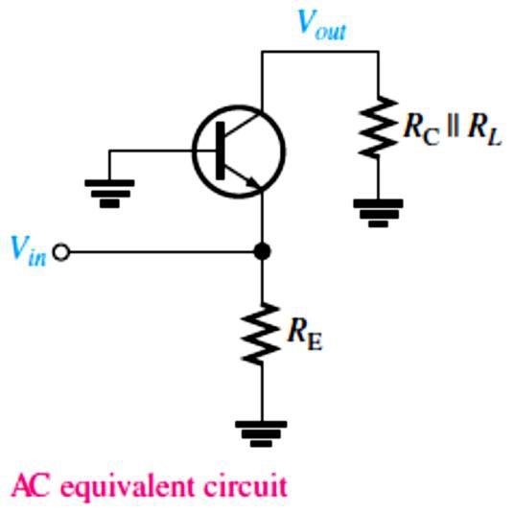
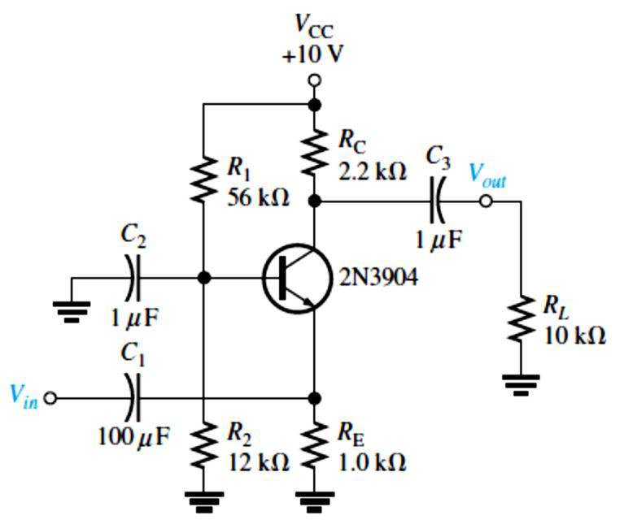
Equivalent Circuits and Formulas: DC formulas:
𝑹_{𝐓�}= (𝑹�𝑹�)⁄(𝑹� + 𝑹�)
𝑹�
𝑽_{𝐓�}= (_{𝑹}
_{+ 𝑹}^{) 𝑽}��
� �
𝑰� = _{𝑹}
^{𝑽}𝐓�^{− 𝑽}��
�
+ 𝑹⁄𝜷
𝐓���
𝑽� = 𝑰�𝑹�
𝑽�� = 𝑽� − 𝑽�
𝑽� = 𝑽�� + 𝑽�
𝑽� = 𝑽�� − 𝑰�𝑹�
AC formulas:
�’� ≅
����
𝑰
�
^{𝑹}𝒊�(��𝒊����) ≅ �’�
^{𝑹}��� ^{≅ 𝑹}�
𝑹�
𝑨� ≅ �’
�
𝑨_{𝒊}≅ �
𝑨� ≅ 𝑨�
EXAMPLE 6-11: Find the input resistance, voltage gain, current gain, and power gain for the amplifier in Figure 6-20. �_{DC} = 250.
FIGURE 6-20
Solution First, we find 𝐼_{E} so that we can determine 𝑟’�. Then �_{𝑖�} ≅ 𝑟’�.
�_{TH} = �
�₁�₂
(56 kΩ)(12 kΩ )
+ �
= = 9.88 kΩ
1
2
56 kΩ + 12 kΩ
�_{TH} = (�
�₂
12 kΩ
) 10 V
+ � ^{) �CC = (}56 kΩ + 12 kΩ
1 2
�_{TH} = 1.76 V
�TH ^{− �}BE
𝐼_{E} = �
1.76 V − 0.7 V
=
1 kΩ + 9.88 kΩ⁄250
E ^{+ �}TH⁄�DC
𝐼_{E} = 1.02 mA
Therefore, �_{𝑖�} ≅ 𝑟’� = 25 mV⁄𝐼_{E} = 25 mV⁄1.02 mA = 24.5 Ω
We calculate the voltage gain as follows: �� = �_{C} ∥ �_{𝐿}= 2.2 kΩ ∥ 10 kΩ = 1.8 kΩ
𝐴� ≅ ��⁄𝑟’� = 1.8 kΩ⁄24.5 Ω = 73.5
Also, 𝐴_{𝑖}≅ 1 and 𝐴� ≅ 𝐴� = 73.5.

Slide 15
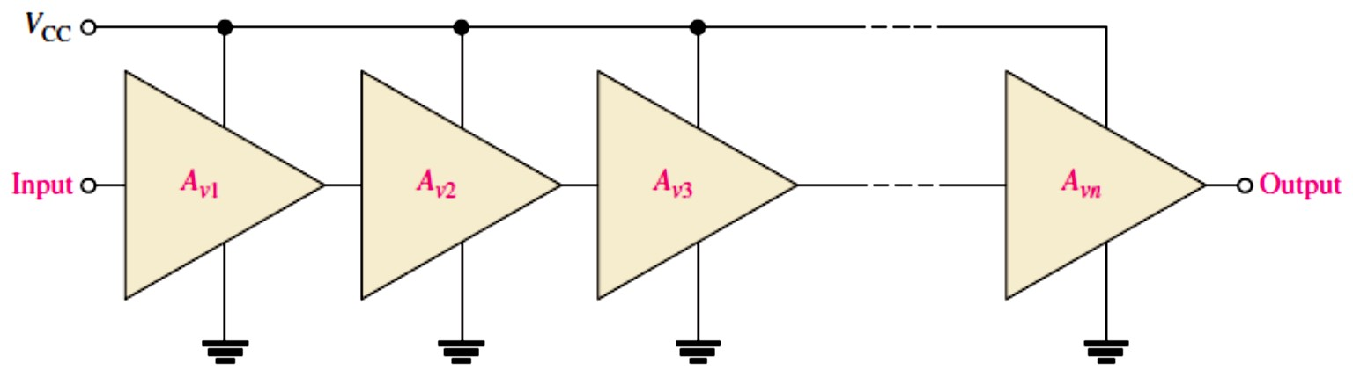
6.6 Multistage Amplifiers
Two or more amplifiers can be connected in a cascaded arrangement with the output of one amplifier driving the input of the next.
Single-stage amplifiers can be connected in sequence with capacitively-coupling and direct coupling methods to form multistage amplifiers.
Each amplifier in a cascaded arrangement is known as a stage.
The basic purpose of a multistage arrangement is to increase the overall voltage gain.
The total voltage gain, 𝐴’�, of cascaded amplifiers, as shown in Figure 6-21, is the product of the individual gains (sum of dB gains).
^{𝑨’}� ^{= 𝑨}��^{𝑨}��^{𝑨}�� ^{… 𝑨}��
FIGURE 6-21: Cascaded amplifiers. Each triangular symbol represents a separate amplifier.
EXAMPLE 6-12: A certain cascaded amplifier arrangement has the following voltage gains:
𝐴_{�1} = 10, 𝐴_{�2} = 15, 𝐴_{�3} = 20. What is the overall voltage gain? Also express each gain in decibels (dB) and determine the total voltage gain in dB.
Solution 𝐴’� = 𝐴_{�1}𝐴_{�2}𝐴_{�3} = (10)(15)(20) = 3000
𝐴_{�1(dB)} = 20 log 𝐴_{�1} = 20 log 10 = 20.0 dB
𝐴_{�2(dB)} = 20 log 𝐴_{�2} = 20 log 15 = 23.5 dB
𝐴_{�3(dB)} = 20 log 𝐴_{�3} = 20 log 20 = 26.0 dB
𝐴’_{�(dB)} = 𝐴_{�1(dB)} + 𝐴_{�2(dB)} + 𝐴_{�3(dB)} = 20.0 dB + 23.5 dB + 26.0 dB = 69.5 dB
6.7 The Differential Amplifier
A differential input voltage appears between the inverting and noninverting inputs of a differential amplifier.
In the differential mode, a diff-amp can be operated with single-ended or double-ended inputs.
In single-ended operation, there is a signal on one input and the other input is grounded.
In double-ended operation, two signals that are 180° out of phase are on the inputs.
Common-mode occurs when equal in-phase voltages are applied to both input terminals.

Slide 16
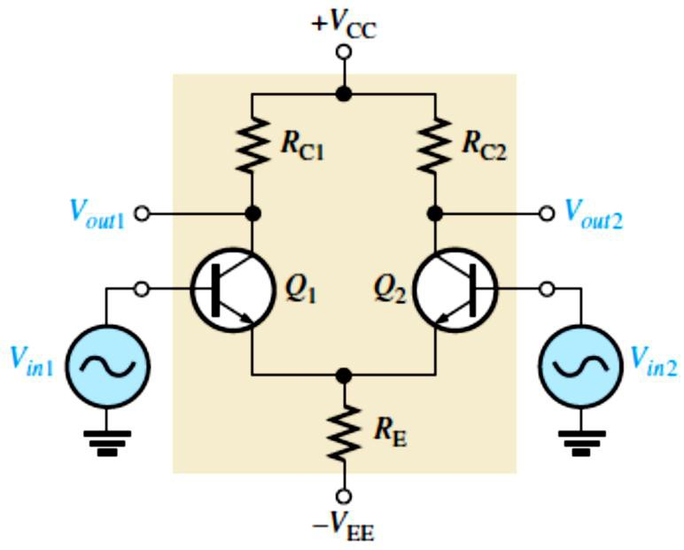
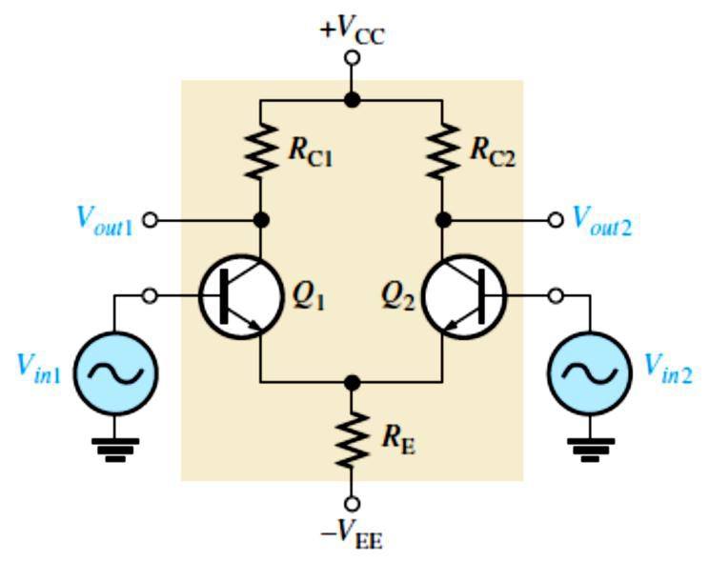
Circuit with Differential Inputs: Double-ended differential diff-amp (shown) signal on both inputs. Input signals are out of phase.
  Single-ended differential inputs (not shown) Signal on one input only. One input connected to ground.
Circuit with Common-Mode Inputs: Both input signals are the same phase, frequency, and amplitude.
The measure of an amplifier’s ability to reject common-mode signals (Unwanted signals or noise) is a parameter called the CMRR (common-mode rejection ratio):
�𝐌𝐑𝐑= 𝑨_{�(�)}⁄𝑨�� , �𝐌𝐑𝐑= �� �𝐨𝐠(𝑨_{�(�)}⁄𝑨��)
EXAMPLE 6-13: A certain diff-amp has a differential voltage gain of 2000 and a common-mode gain of 0.2. Determine the CMRR and express it in decibels.
Solution
𝐴_{�(�)} = 2000, and 𝐴�� = 0.2. Therefore,
CMRR = 𝐴_{�(�)}⁄𝐴�� = 2000⁄0.2 = 10,000
Expressed in decibels, CMRR = 20 log(10,000) = 80 dB

